Slide 1
Zomato Case Study
Parkash Meghwar

Slide 2
Data Cleaning & Preprocessing
Dataset shape: 211944 rows and 23 columns
After dropping duplicates: 60411 rows and 23 columns
Total Missing values: 16285

Slide 3
Exploratory Data Analysis
In the first part of EDA, we are proceeding through generating plot for categorical columns, as we know data contains more 60000 rows.
The 2nd Part of EDA mainly focuses on visualization of numerical columns.

Slide 4
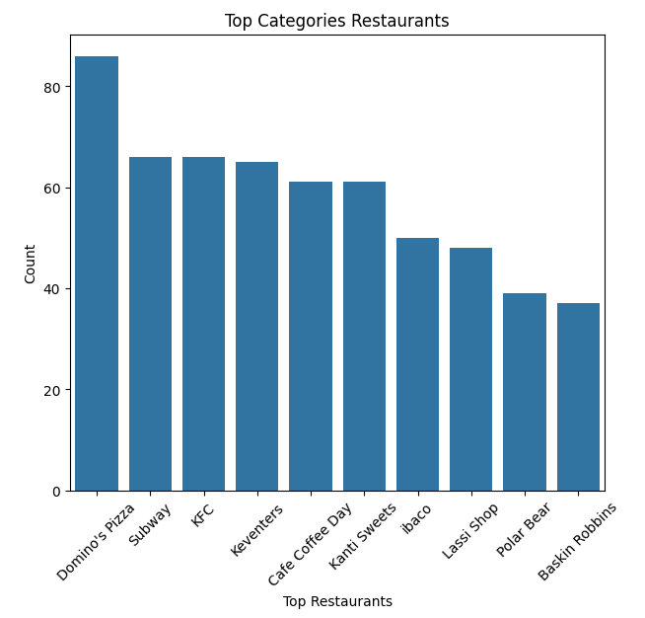
EDA - Part 1

Slide 5
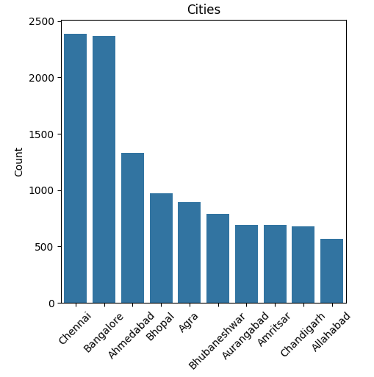

Slide 6
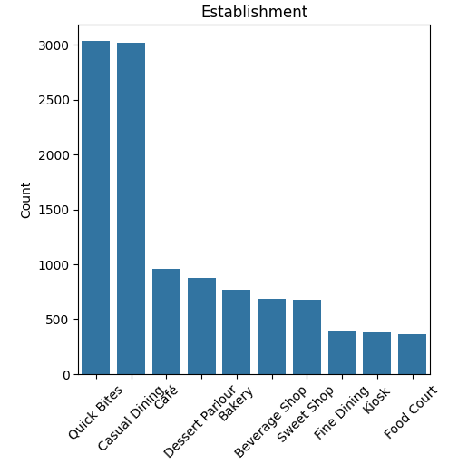

Slide 7
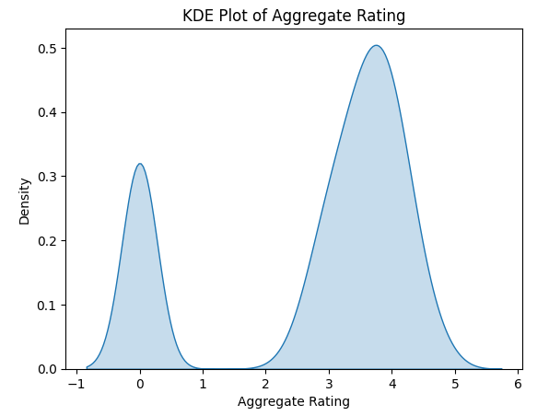
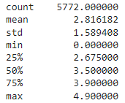
EDA - Part 2

Slide 8
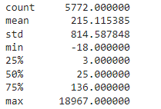
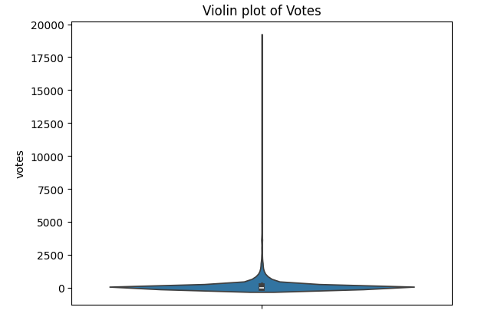
Cumulative votes for Restaurants

Slide 9
Regional Analysis
Zirakpur city has the highest sales of Wraps, Sandwich, Salad, Pizza, Burger, Beverages for The Tea hut charged 30000 of average cost of two.
Mostly restaurants are located in big cities like Bangalore and Chennai with highest food trends & preference patterns..

Slide 10
Customer Preference Analysis
Customers preferred Quick Bites and Casual Dining.
Customers didn't preferred Afghan food at all, and all the trend is towards fast food.

Slide 11
Competitive Analysis
Aggregate Rating of restaurants
23 restaurants with 4.9 aggregate rating.
333 restaurants with 3.9 aggregate rating.
In Banglore, Byg Brewski brewing company company voted highest with 18967.
Vaishnu The Cake Makers is voted most worst with -18 located in Agra.
960 restaurants were voted 0.

Slide 12
Market Gap Analysis
Domino’s Pizza has the highest performance with respect to sales, while Subway is competing on 2nd place along with KFC.
Its seems that Polar bear, lassi group, and keventures need to work on price and cuisines.
There is no strong relationship exists between aggregate rating, votes, delivery and takeaways.

